Slide 1
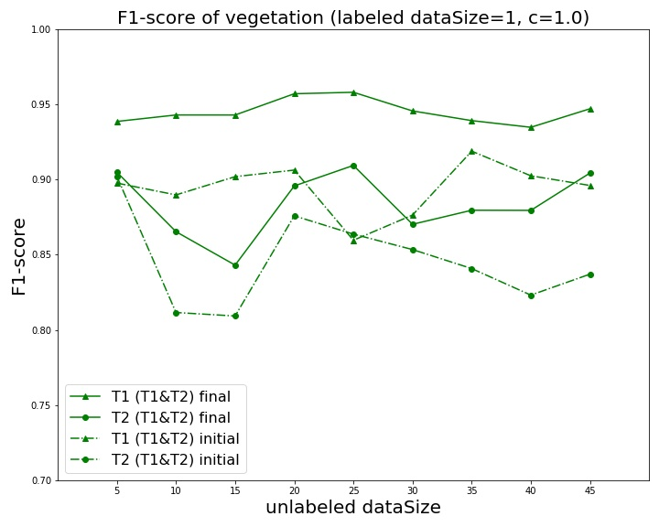
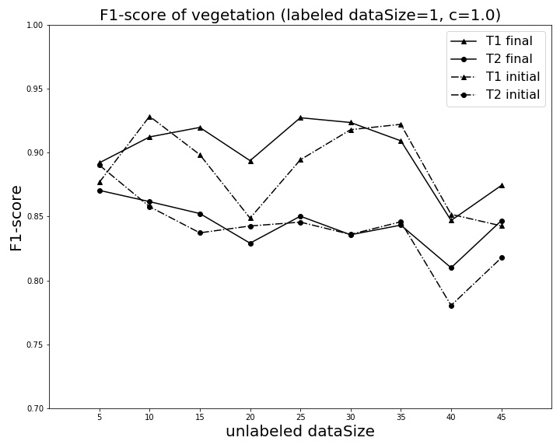
横坐标从迭代次数改为每轮迭代未标记样本增加的数量，增加了实验次数和采样数量

Slide 2
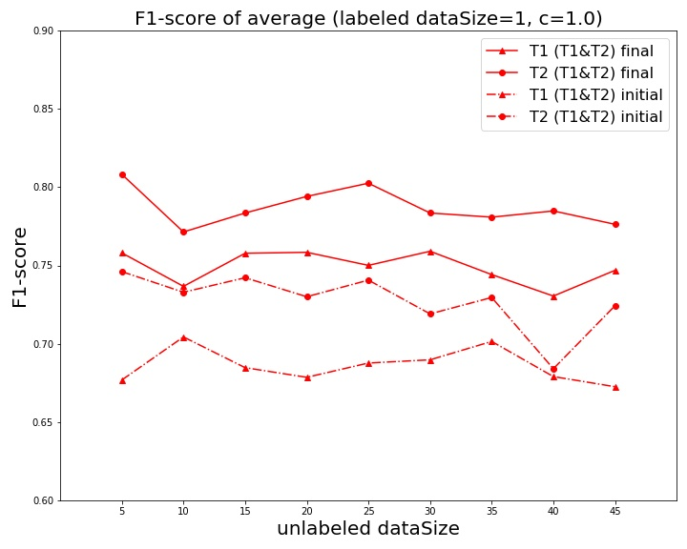
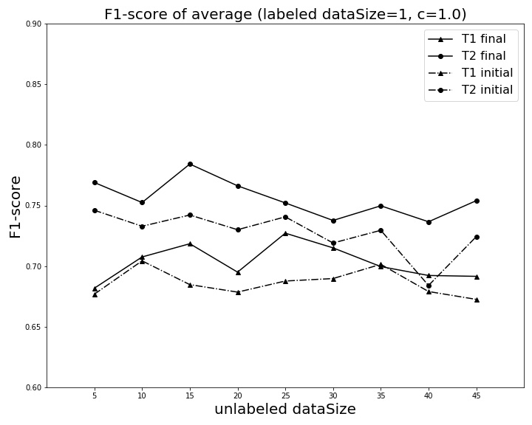

Slide 3
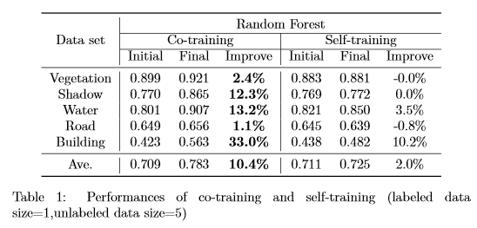
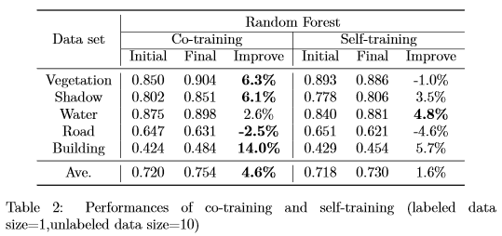
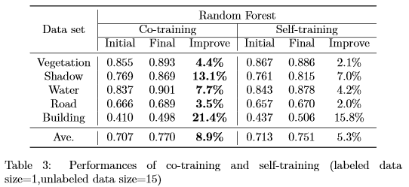
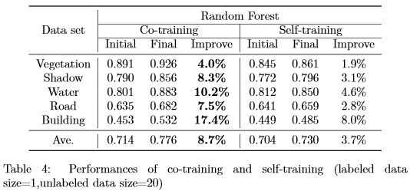

Slide 4
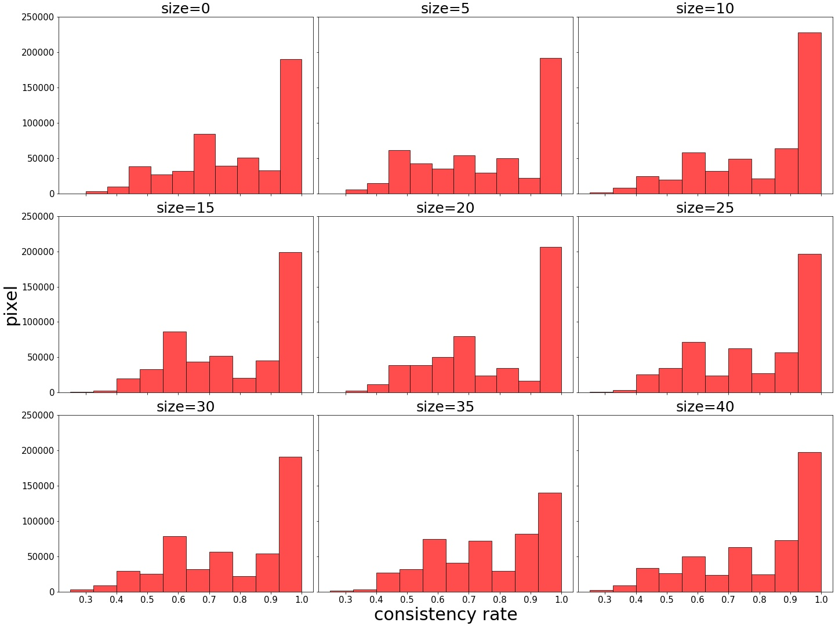
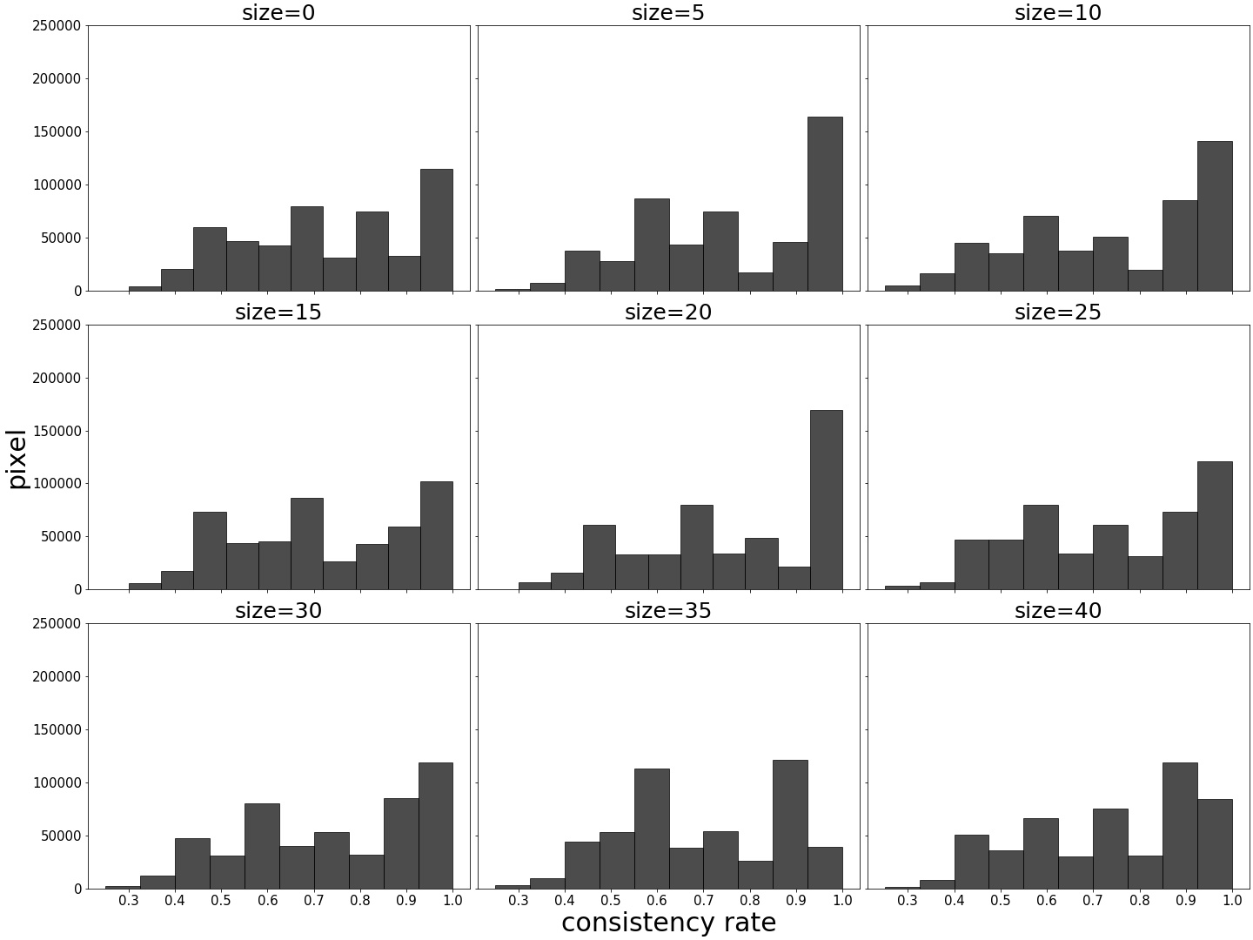
有标记样本20次独立重复采样下，分类结果一致性比率
co-training (labeled dataSize=1)
self-training (labeled dataSize=1)

Slide 5
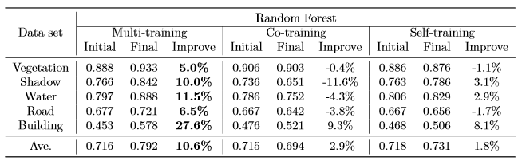
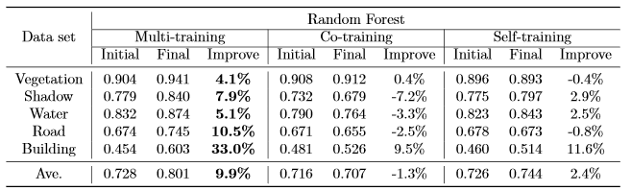
Table 1: Performances of multi-training, co-training and self-training (labeled data size=1, unlabeled data size=5)
Table 2: Performances of multi-training, co-training and self-training (labeled data size=1, unlabeled data size=10)

Slide 6
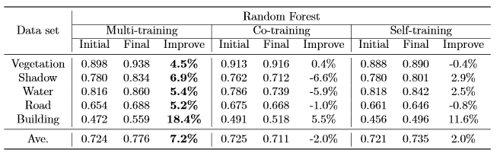
Table 3: Performances of multi-training, co-training and self-training (labeled data size=1, unlabeled data size=15)

Slide 7
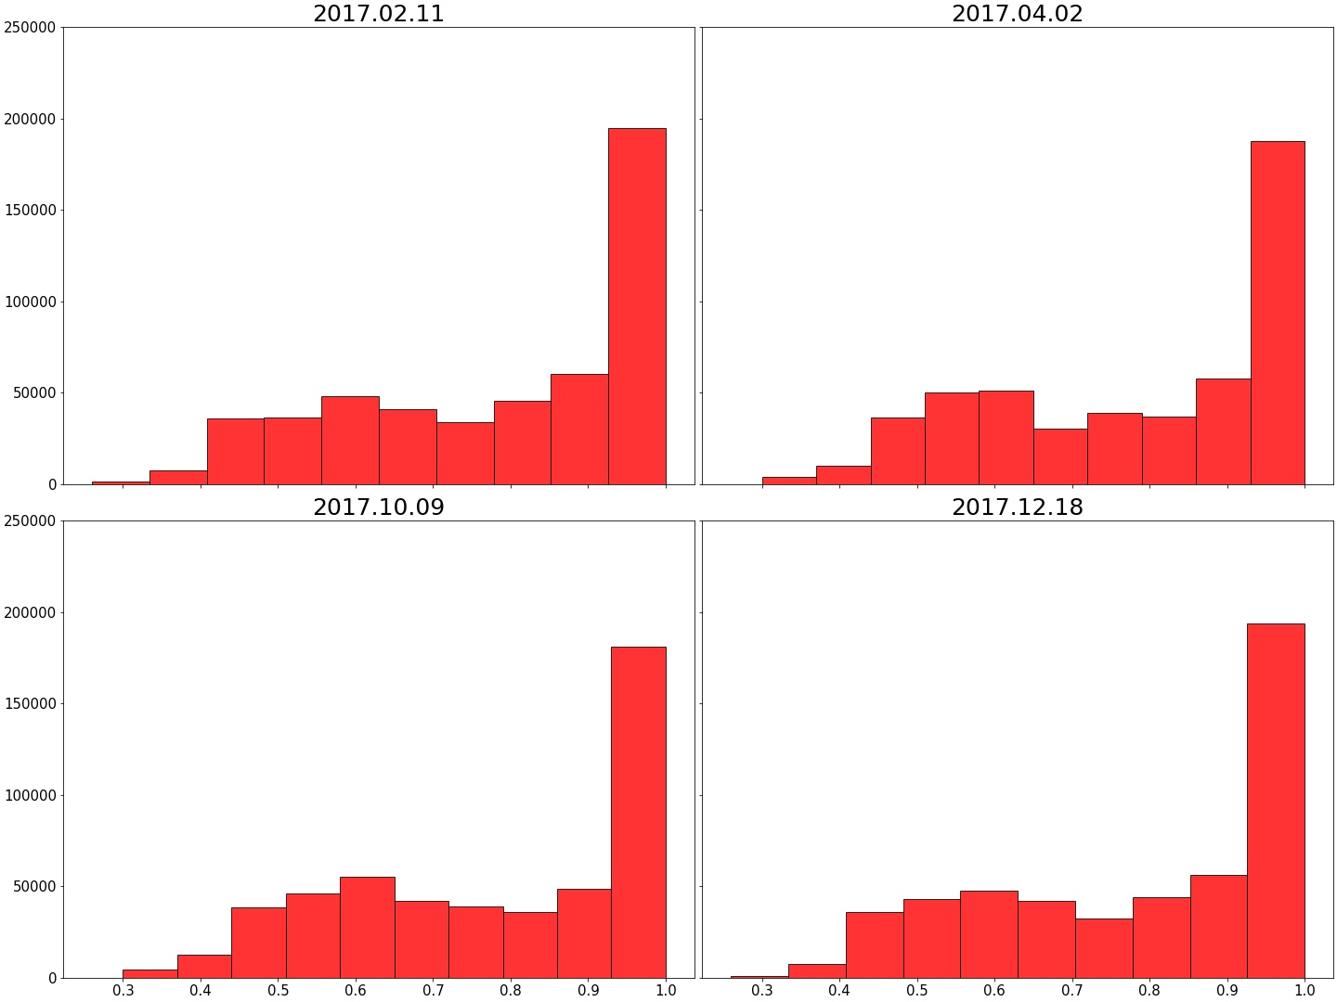
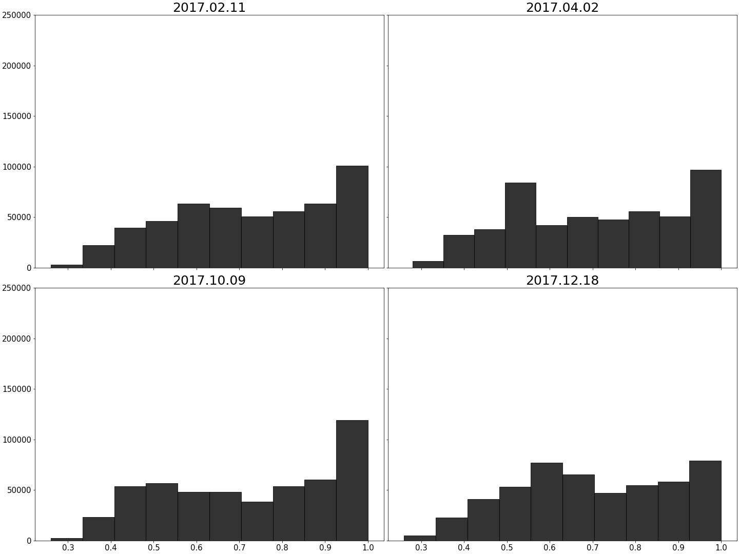
Multi-training (labeled dataSize=1)
Self-training (labeled dataSize=1)

Slide 8
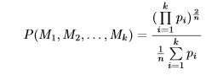
n iterations
Fig 1. We design a semi-supervised learning framework for multi-temporal cooperative training (Multi-training). The results of each epoch of training are combined to calculate joint probability (shown in Eq 1) , and then updated training samples following the threshold. The detailed training pattern is shown in the figure.
Classifier 1
Classifier 2
. . .
Classifier k
Input images
Confidence map
Predicted results

Slide 9
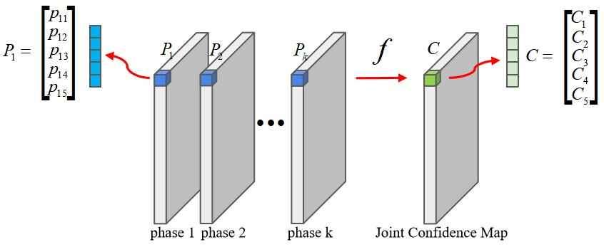

Slide 10
2017年02月11日

Slide 11
2017年04月02日

Slide 12
2017年10月09日

Slide 13
2017年12月18日

Slide 14
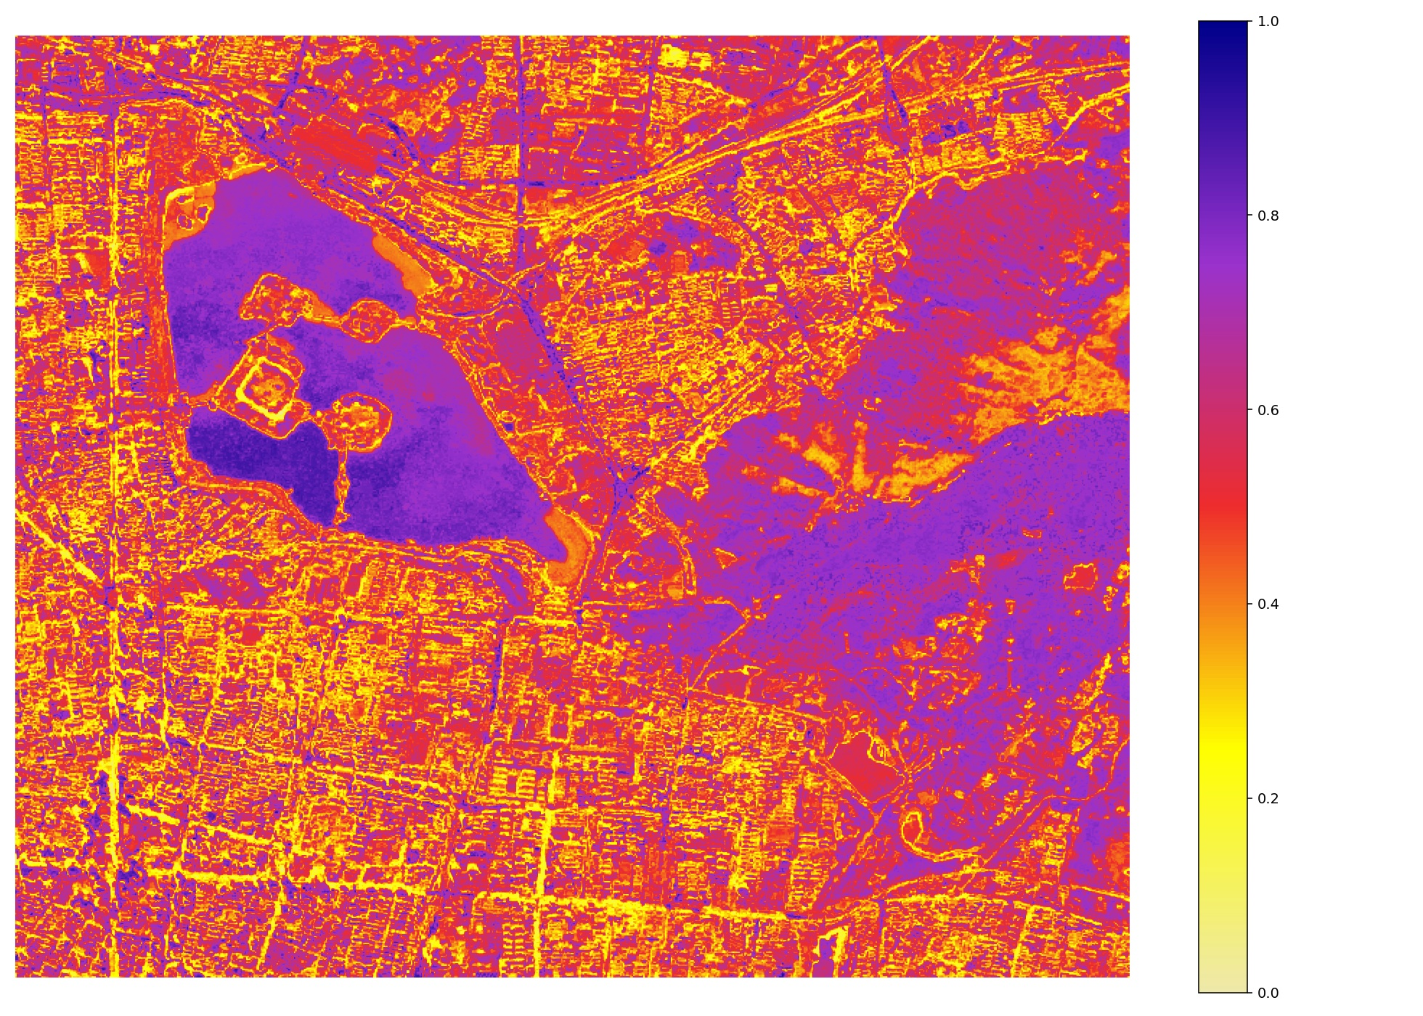
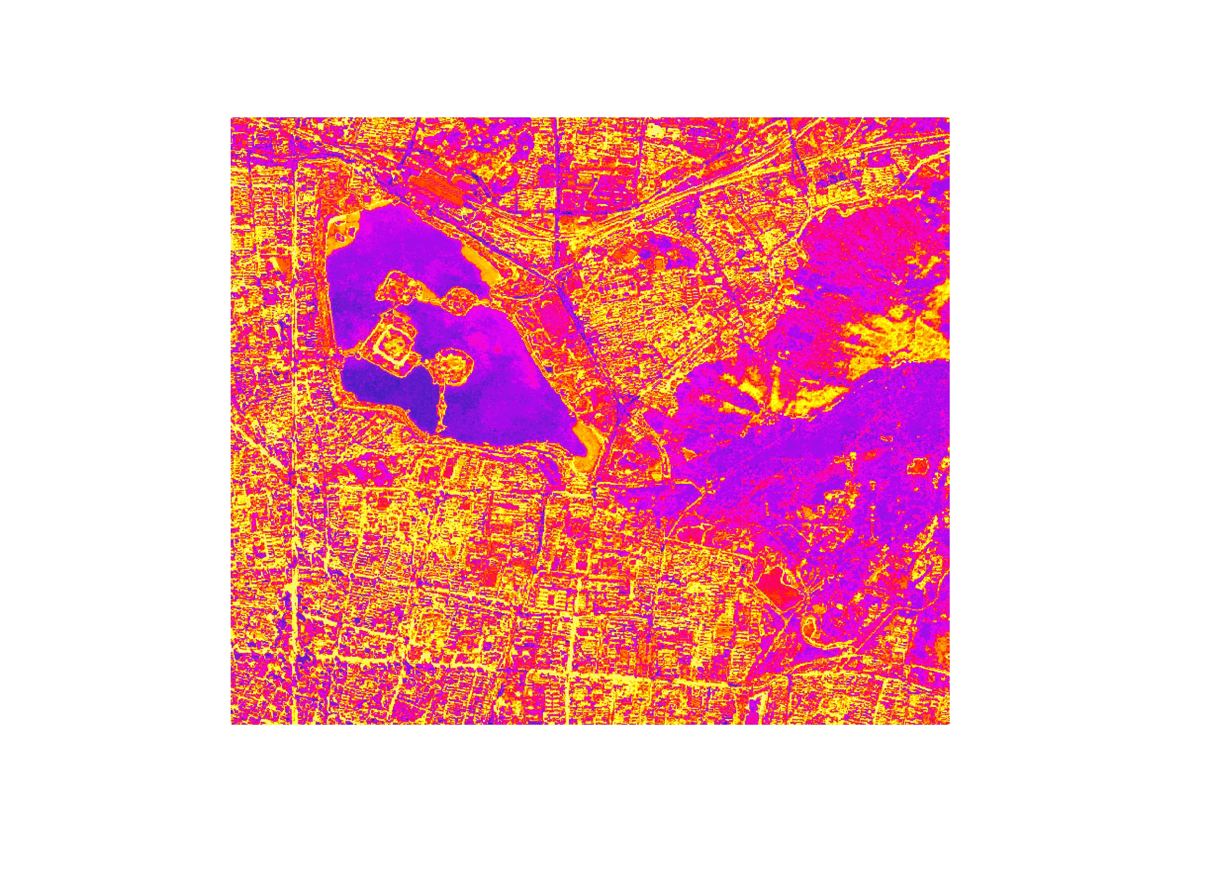
1.0
0.8
Unchanged
Area
0.6
Mean
0.4
Changed
Area
0.2
0.0
Fig 1. In this map, we provide an intuitive display about the model's division of the change area and the unchanged area between each time phase. When the average value is used as the threshold, there are enough samples of the unchanged area in the graph for selection during training. Multi-training provides an implicit framework to judge change samples.

Slide 15
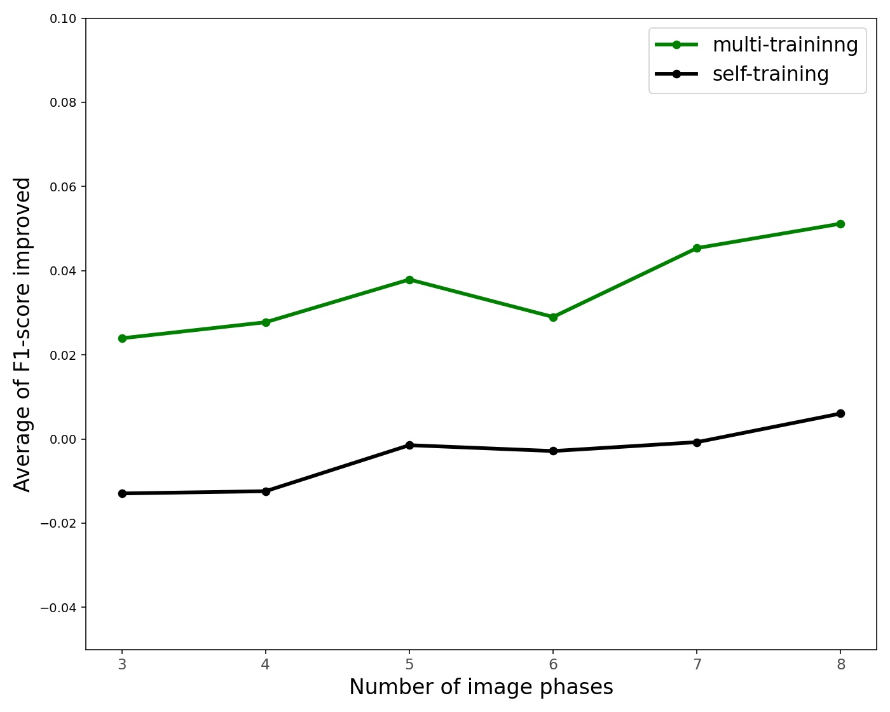
Fig 2. Average F1-score improved of green cover extraction of three (T1–T3), four (T1–T4), five (T1–T5), six (T1-T6), seven (T1-T7) and eight (T1-T8) phases of images on the focus area.

Slide 16
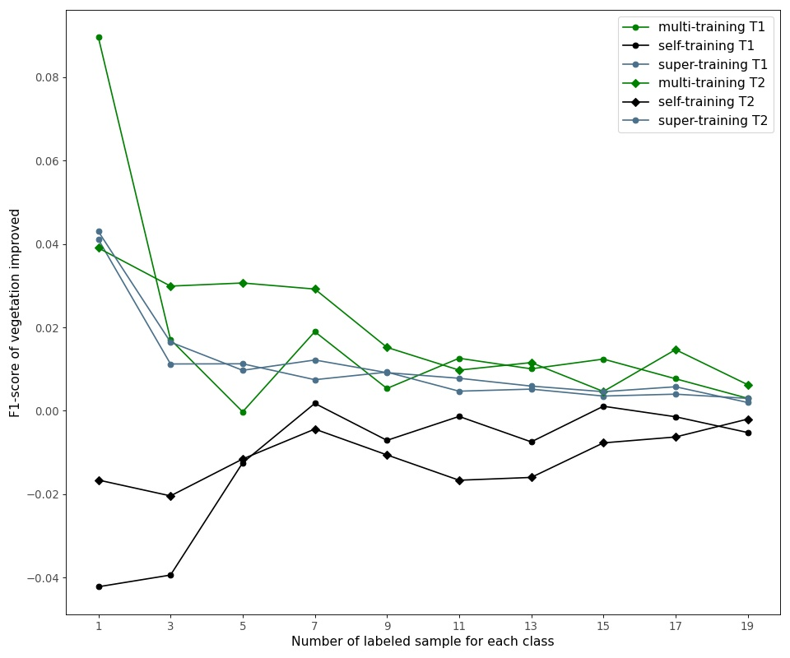
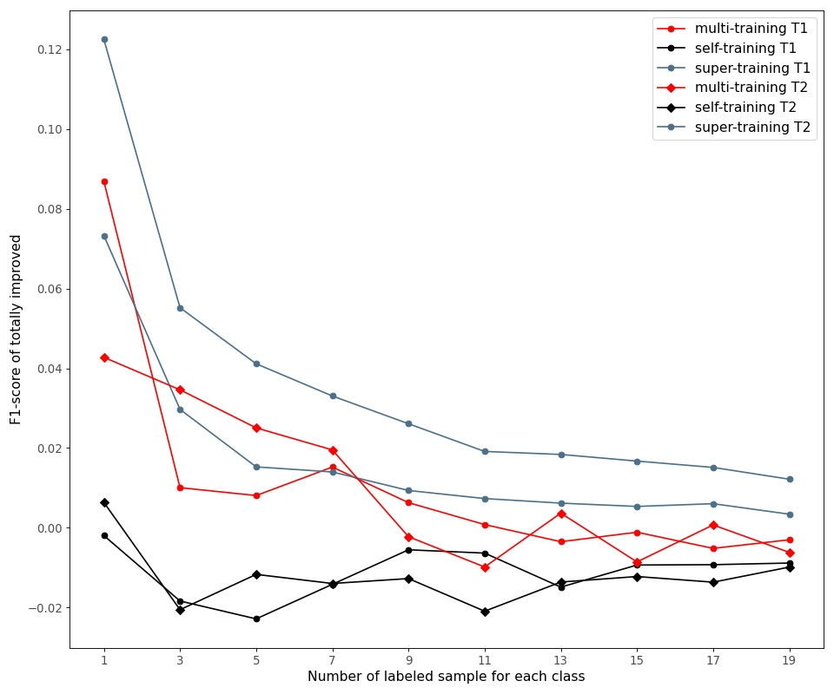
1. 高分辨率遥感影像是城市植被覆盖信息提取以及地物分类的重要数据源，但是数据标注成本昂贵，本研究实现了在小样本情况下对于分类精度的提升（与大规模样本标注的监督学习对比）
(a)
(b)
Fig 3. We compare the improvement of recognition accuracy with different number of labeled samples in three modes. In (a), the accuracy of multi-training for vegetation recognition exceeds that of self-training and large-scale sample labeled supervised training. As shown in (b), in terms of overall accuracy, the improvement of multi-training is beyond self-training, even close to the effect of supervised learning under large-scale labeled sample.

Slide 17
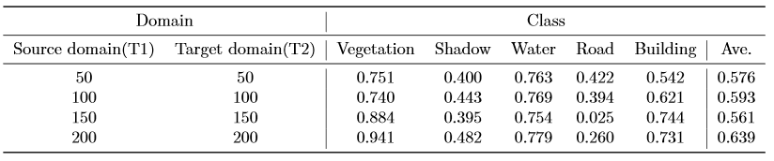
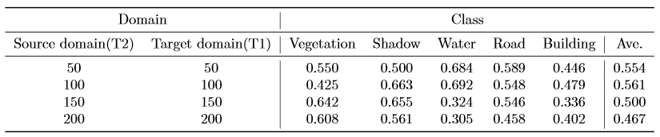
2. 不适定问题：由于地表条件以及成像环境的变化，一个时相下的样本无法直接应用于另一个时相下的分类（常用思路：领域自适应，迁移学习），迁移学习能够解决源域和目标域样本的迁移，但是仍需要大量标记样本，计算存储开销较大
Tab 1. We apply transfer learning on two-temporal remote sensing images with setting T1 as source domain and target domain, T2 as target domain and source domain. Transfer component analysis (TCA) method is used here. Here listed recognition accuracy of each object by transfer learning under different number of labeled samples.

Slide 18
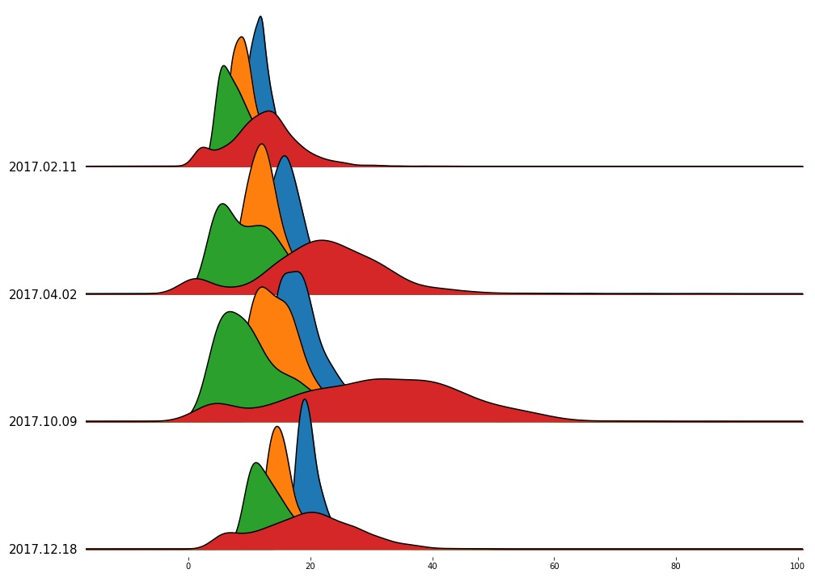
3. 本研究解决了数据偏移带来的影像，并将时间序列上的数据偏移问题转化成了推导各时相间地物分类的驱动力。
Fig 4. Here we show the difference of remote sensing image data distribution in multiple phases. It can be seen that the data of each band in different phases have a large deviation which brings challenge to training.

Slide 19
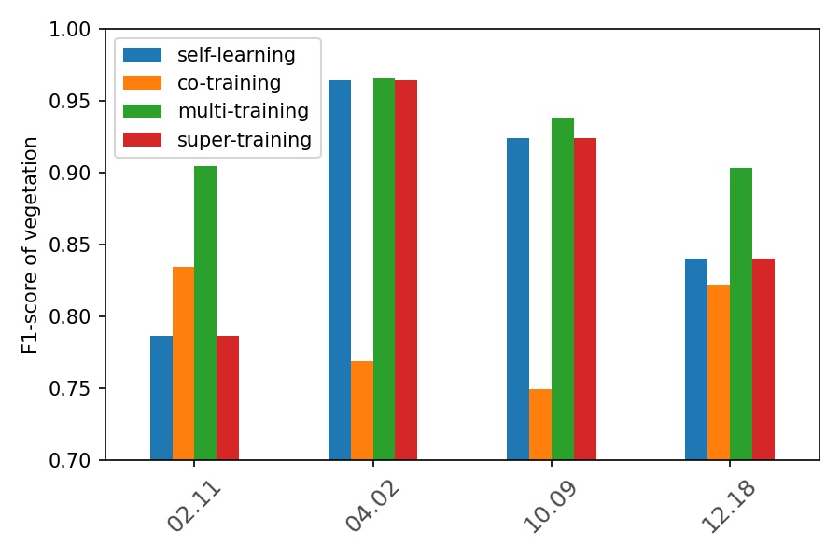
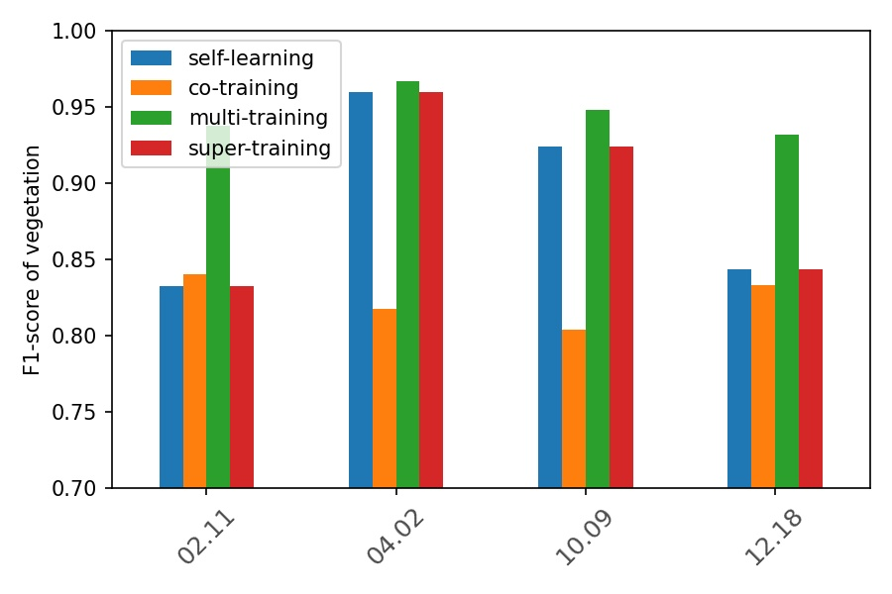
(a) labelsize=1, unlabelsize=5
(b) labelsize=1, unlabelsize=5
Fig 5. Here we compare performances of different methods in multiple phases. It can be seen that Multi-training achieve the best results in each time phase.

Slide 20
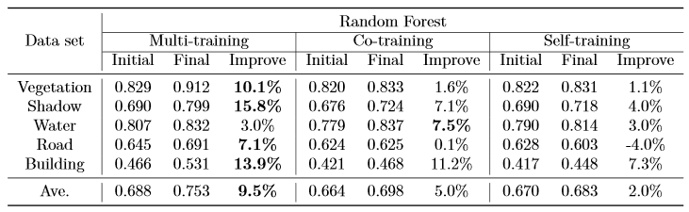
4. 半监督学习：在多时相下利用协同训练识别山区积雪覆盖信息(zhu et al., 2016) 为多时相下的地物分类提供了一条新思路，但是实验和方法集中在两个时相间进行协同学习，由于积雪这一类地物的特征空间维度较低，而城市地物分类中地物种类多，特征空间维度较高，直接应用该方法不能完全满足任意两时相间的地物协同训练下的分类。
Tab 2. We apply the three methods on training of the images of T1, T2, T3 and T4 with the setting that labeled sample's size is 1 and adding unlabeled sample's size is 5 each epoch, then obtain the result follow these steps: (a) directly get the F1-score of T4 for Multi-training on T1, T2, T3, and T4 (b) compute the average F1-score of T4 for Co-training on T1&T4, T2&T4, T3&T4 (c) compute the average F1-score of T4 for Self-training on T1&T4, T2&T4, T3&T4

Slide 21
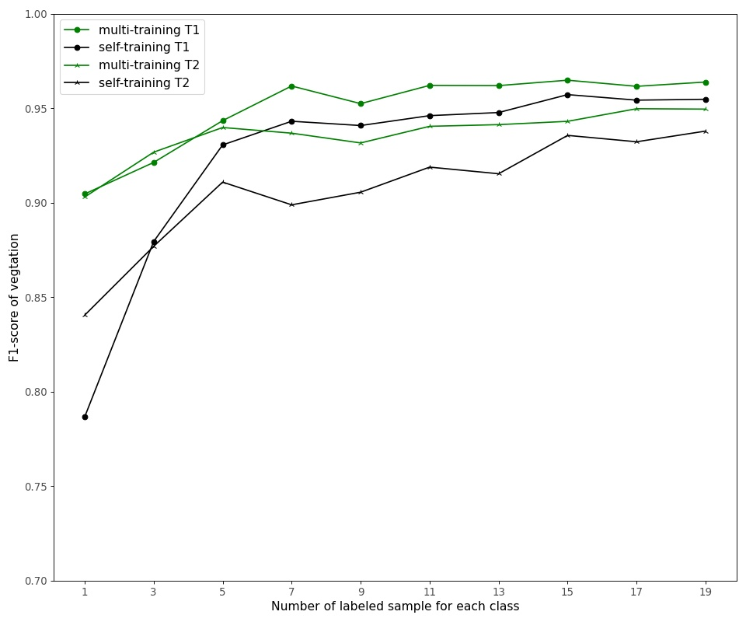
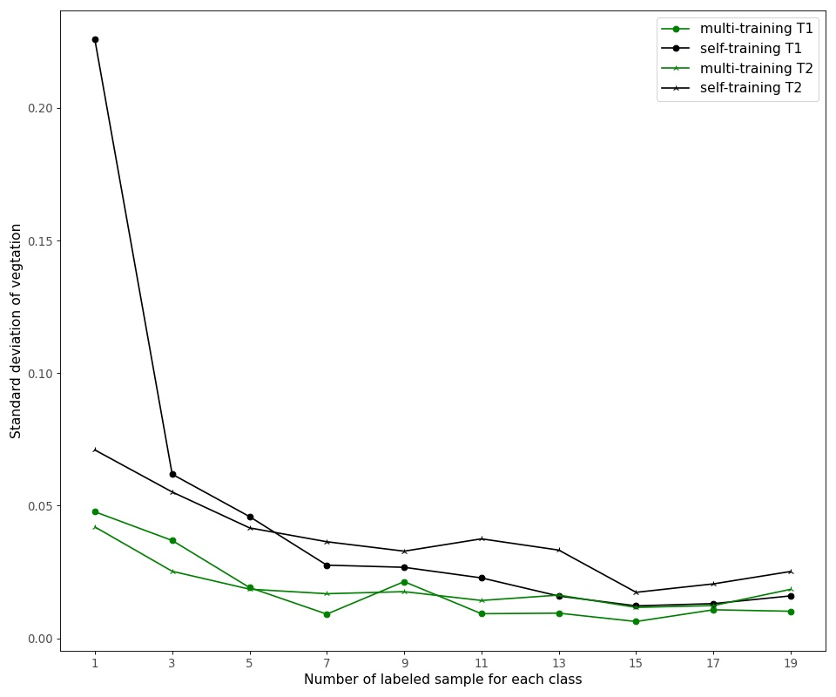
5. 本研究在长时间序列整体的角度上，对于城市地物进行协同分类，充分利用已有的数据，不再是孤立地考虑两个时相间的地物信息挖掘，在分类精度和一致性上相比于两时相间协同训练以及单时相主动学习的方法获得更好的效果。
(a)
(b)
Fig 6. Average F1-score and standard deviation on vegetation of Multi-training and Self training with different labeled sample number. (a) is the average F1-score and (b) shows the corresponding standard deviation.

Slide 22
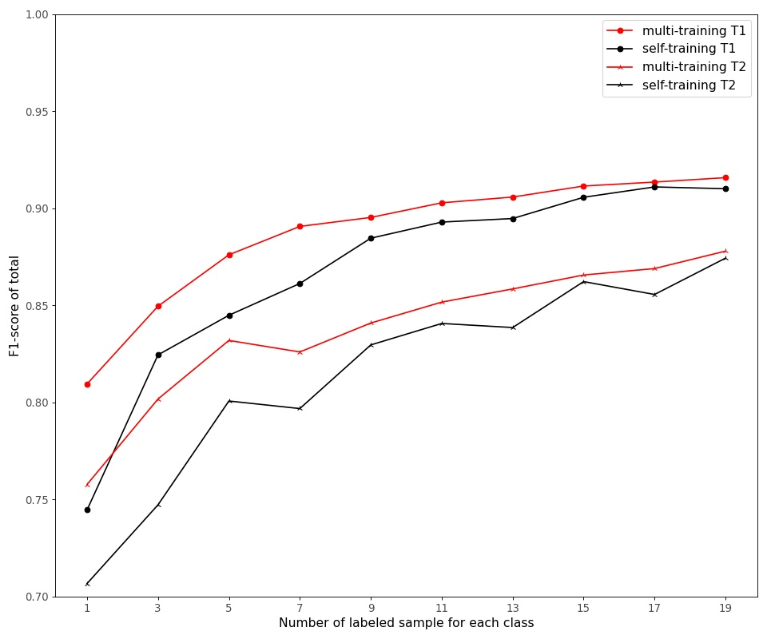
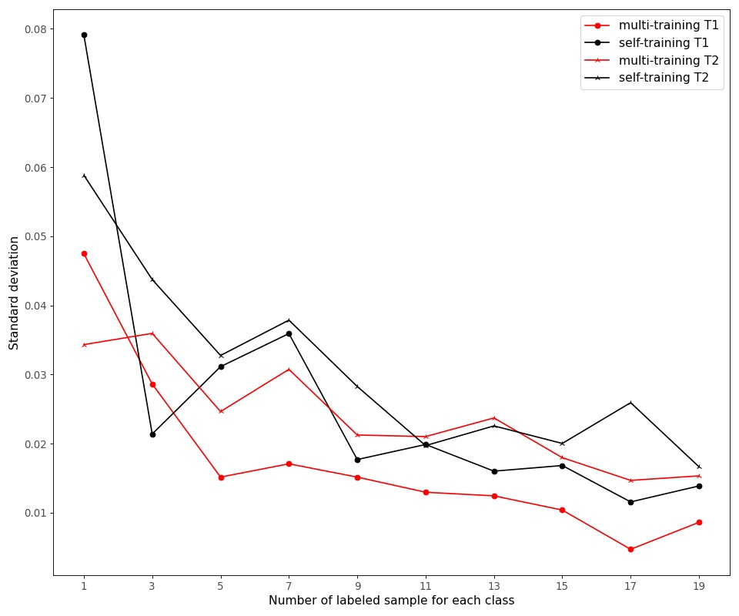
Fig 7. Global average F1-score and standard deviation of Multi-training and Self training with different labeled sample number. The left one is the average F1-score and the right one is the corresponding standard deviation.

Slide 23
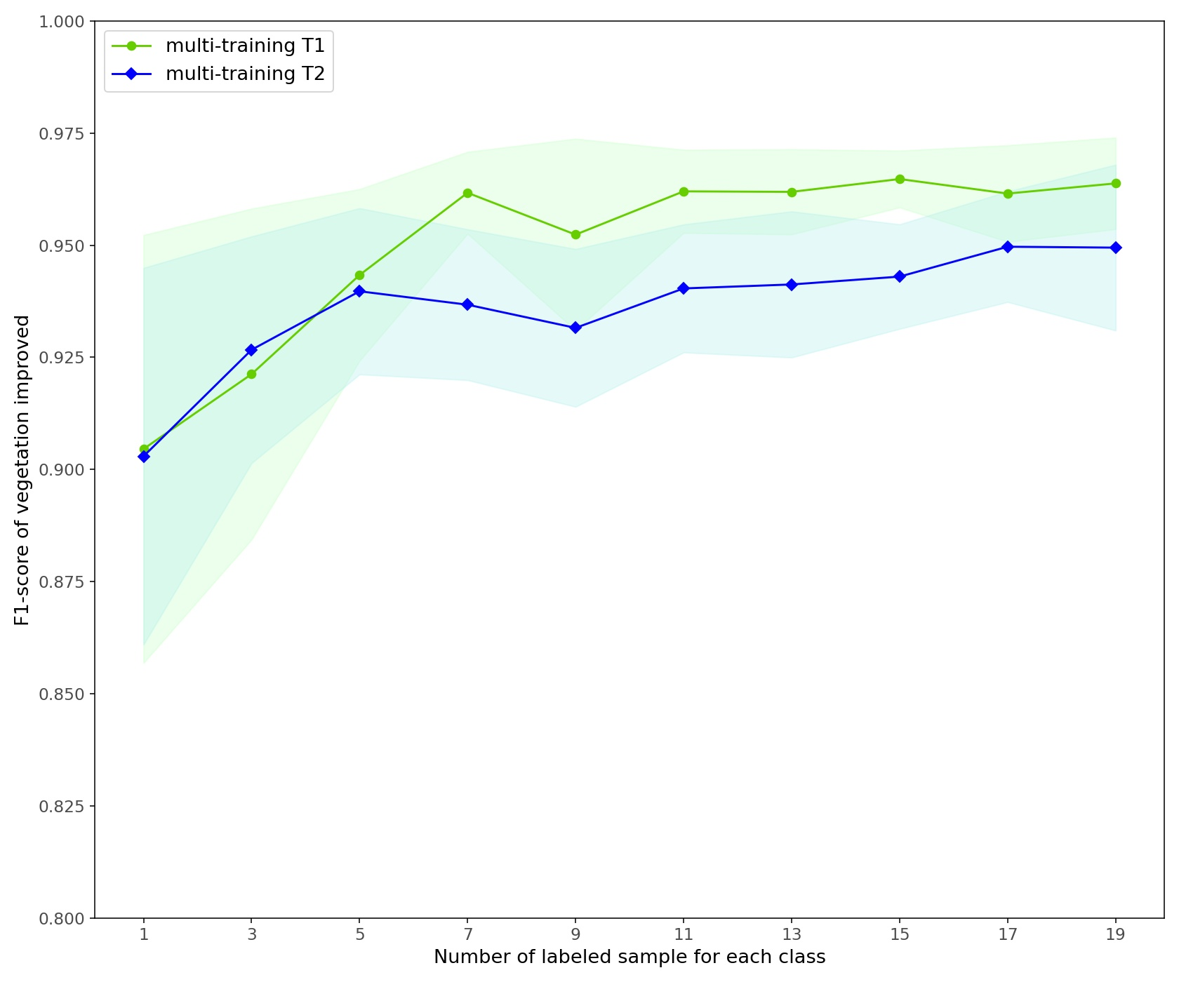
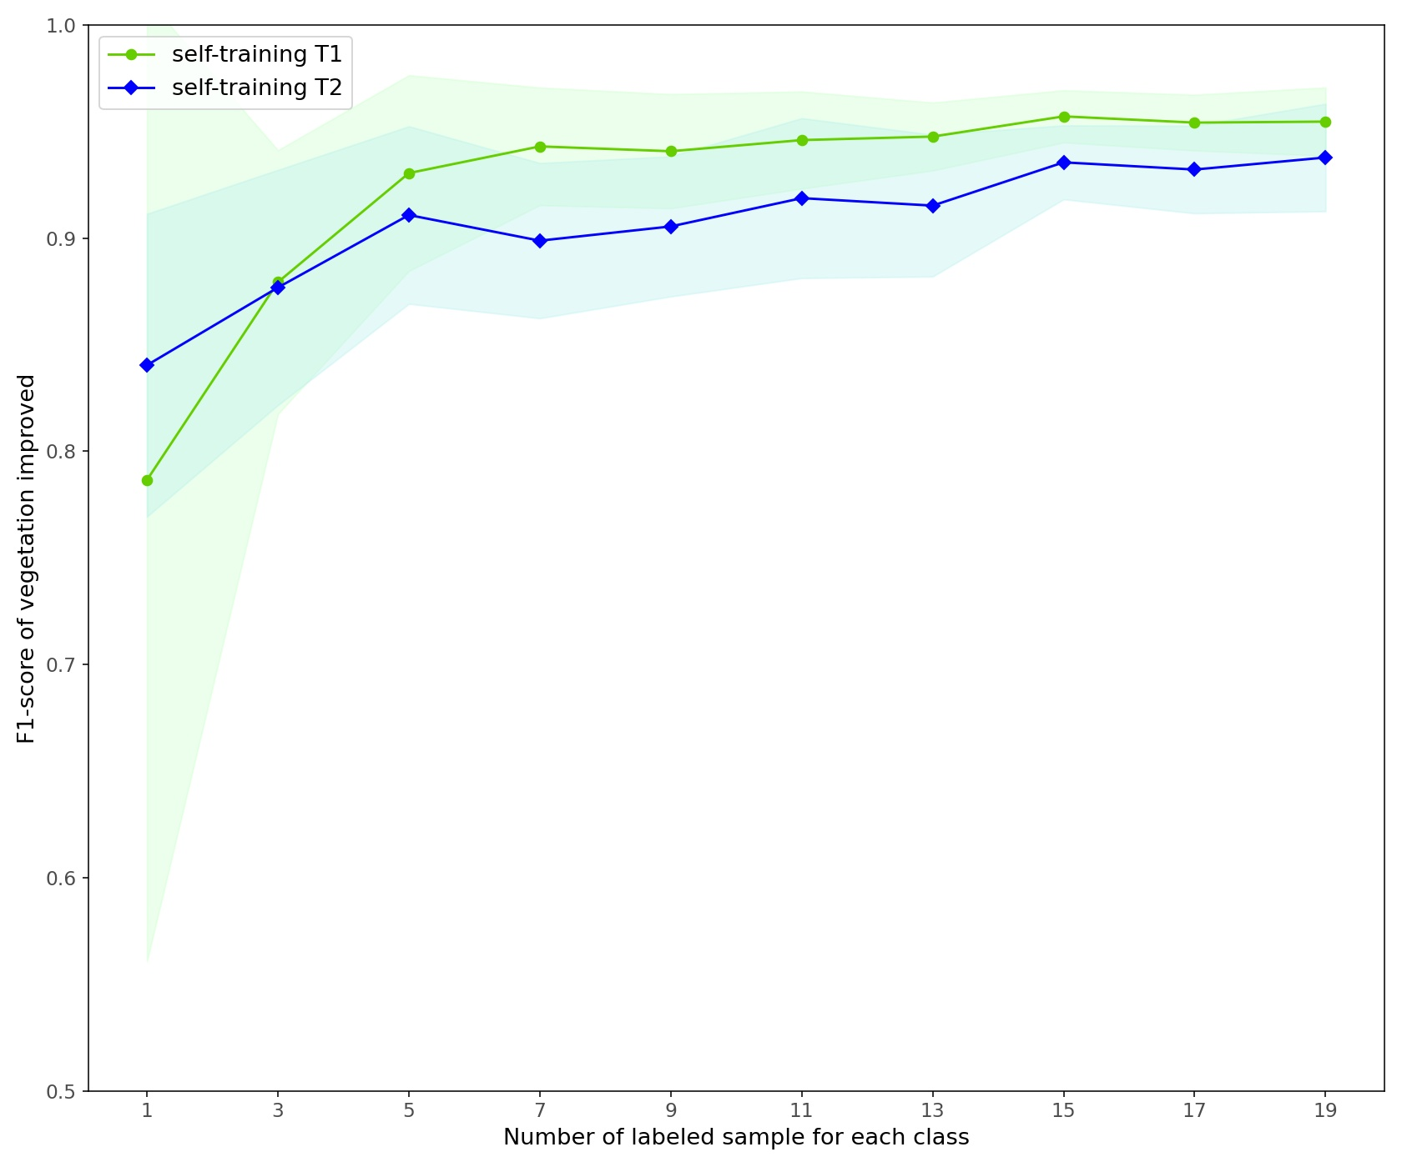

Slide 24
